Slide 1
Social Network Analysis Focused Research Process
Sean P. Goggins, Ph.D

Slide 2
Agenda: Day 2
SNA Process
Conceptual
Use Specific Scripts for each step

Slide 3
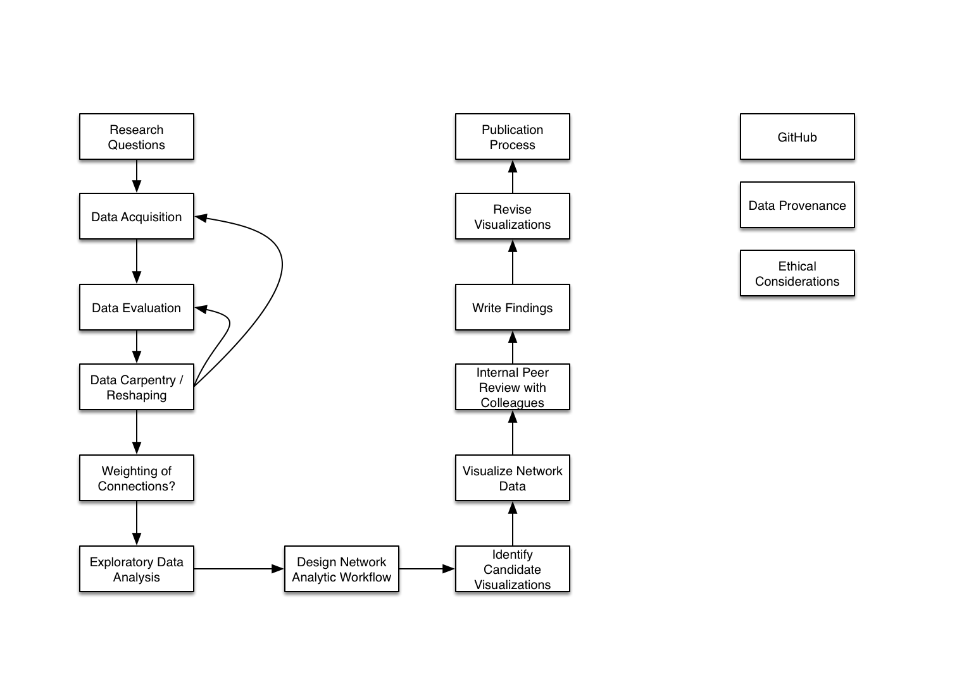
High Level Overview

Slide 4
Data Evaluation
Is the data shapable into a network?
2 nodes
Other Metadata
Direction
Timestamps, which can be useful for weighting the networks later
Weight Connections

Slide 5
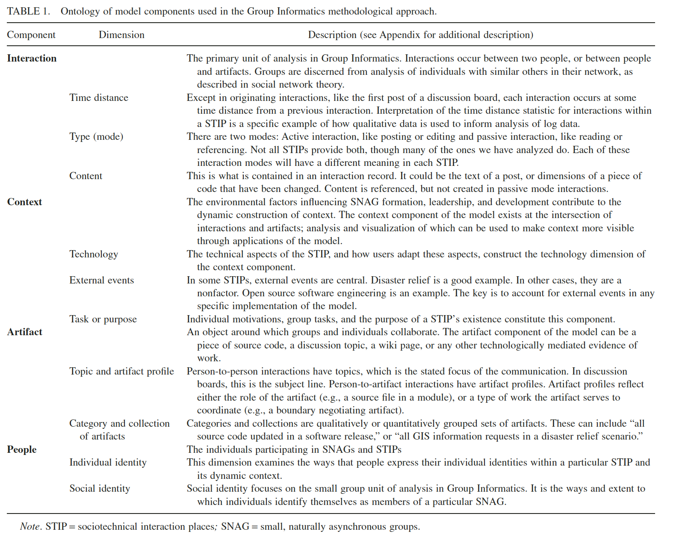
Weighting Questions

Slide 6
Reshaping to Network Data
Original File:
mdl_forum_posts_scrubbed.csv
SQL Transformation
SELECT * INTO mdl_forum_posts_snadata FROM (SELECT p2.id, p2.userid AS userid_from, p2.created, p1.userid AS userid_to FROM mdl_forum_posts p1 JOIN mdl_forum_posts p2 ON p2.parent = p1.id) data;
Network File:
mdl_forum_posts_scrubbed_snadata.csv

Slide 7
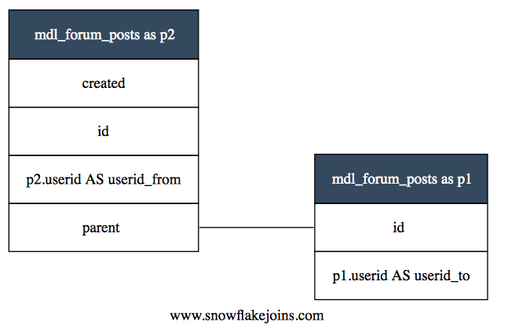
Reshaping

Slide 8
Thank You

